Slide 1
Uber Supply-Demand Gap

Slide 2
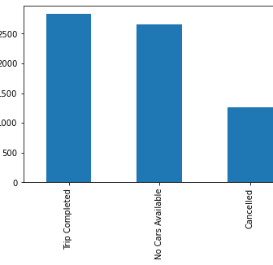
Analyzing uber Data set
From the data set we can see that there are 6745 requests among which only 2831 requests are satisfied i.e completed their trip.
And remaining 58.03% requests are either cancelled by the driver or cancelled due unavailability of cars.

Slide 3
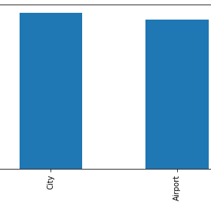
Among those problematic requests most of the requests are cancelled when the request type is from City to Airport.

Slide 4
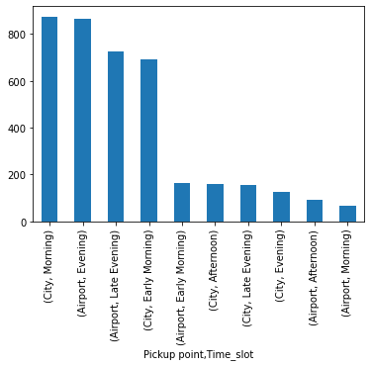
From the graph we can see that city to airport request is the most problematic request type in the morning time slot.

Slide 5
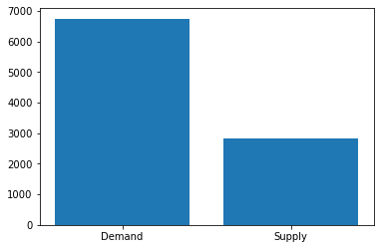
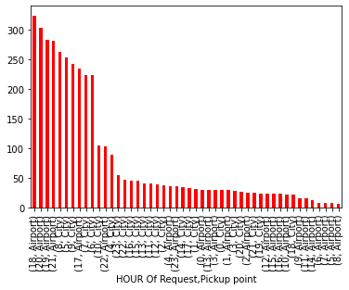
Here we can see that there is huge gap between the demand and supply.
As we can see in the above graph the demand is more but the supply is less when the type of request is Airport - City at 6:00pm in the evening

Slide 6
Reasons for the Supply-Demand Gap
For trips originating from the Airport, most probable reasons for such a huge Non Availability of Cars during Evening and Night request time slots are:
• For most of the driver partners this time period is the end of their working hours thus leading to non-availability of cars at the airport
• Also since the frequency of flights landing after these time slots start reducing the wait period for the driver partner is increased for a passenger to board a trip from Airport thus they are reluctant to be at the airport at these time slots
• For trips originating from the City, most probable reasons for such a huge Cancellation during Early Morning and Morning request time slots are:
• Higher waiting period at the airport after these time slots
• Chances of more trip completion and higher earnings if choosing a trip that is not bound for airport

Slide 7
Ways to resolve Supply-Demand Gap
1. Incentivize trips to Airport from City during the problematic request time slots i.e. Early Morning and Morning
2. Incentivize driver partners to be available for ride at Airport to City during problematics request time slots i.e. Evening and Night

